Slide 1
Radio Signals & Security - Part 2
By Abdul Rasheed and Rajesh TV
@nullDubai
Our efforts are to spread the awareness and purely for Education purpose only.

Slide 2
Agenda
Radio Frequency – Part 2
Exploring Software Define Radio
SDR Technology
Introduction to GNU and frequency usage
What is DSP, modulation and it's type?
Tools of Trade
Hackrf with GNU, SDRSHARP & URH
Demo
Exploring SDR with Hackrf and tuning in air.
Investigating Walkie-Talkie communications. Controlling Radio device.
GPS Spoofing.
References
Q&A

Slide 3
Digital Signal Processing
Takes Samples from Analog Signals
Converts Analog to Digital and vice versa
Works on voice, audio, video etc
Improves the accuracy and reliability of digital communications
Uses ADC & DAC

Slide 4
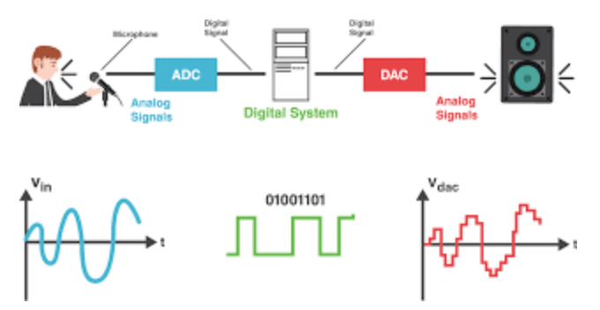
How Does it Work?
The antenna will accept the Analog signals and the ADC will sample the signals
The Signals can be modified using the software like GNU Radio
Convert back the signals to Analog

Slide 5
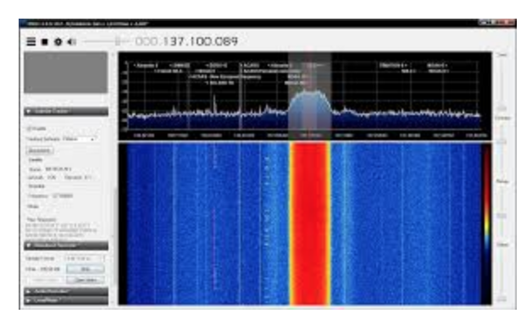
SDR Technology
Radio Communication system where hardware components are implemented in software
Basic SDR consists of a PC with an RF front end and a ADC/DAC converter
Used widely in both civilian and military services
Advantages include reduction of cost , adaptability and experimentation
Notes:
http://www.scielo.org.co/pdf/rfing/v24n38/v24n38a07.pdf

Slide 6

What is GNU Radio?
Open Source framework that enables users to design, simulate, and deploy highly capable real-world radio systems.
It is a highly modular, "flowgraph"-oriented framework
Comes with a comprehensive library of processing blocks that can be readily combined to make complex signal processing applications
The GNU radio live sdr is a nice linux based Environment with support for Hackrf and of course, GNU Radio.
Notes:
https://wiki.gnuradio.org/index.php/Guided_Tutorial_Introduction

Slide 8
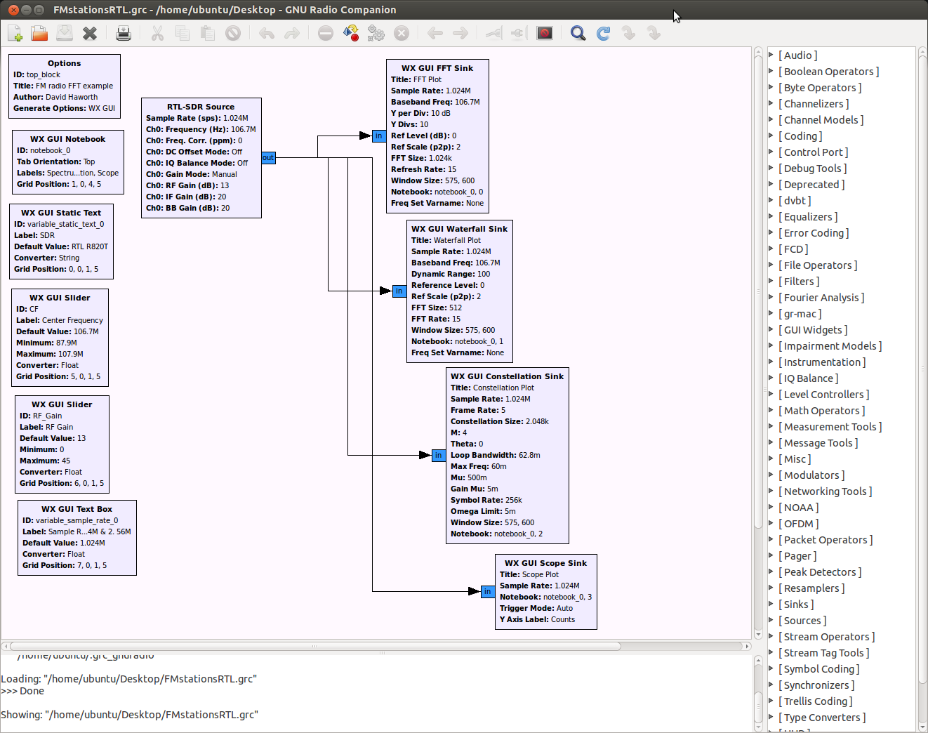
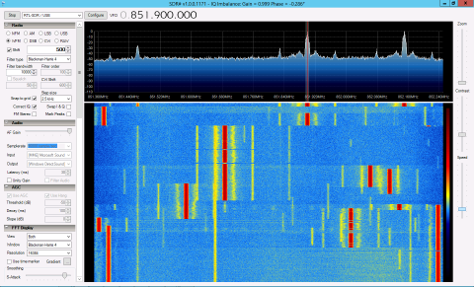


High Frequency Radio Signals
Incase you missed our last talk which is completely focused on Low Frequency radio Signals, presentation file available on null Dubai GitHub repo for your reference. (https://t.co/7uPbQiBzxp)
Today we are going to focus on High Frequency Radio Signals.

Slide 9
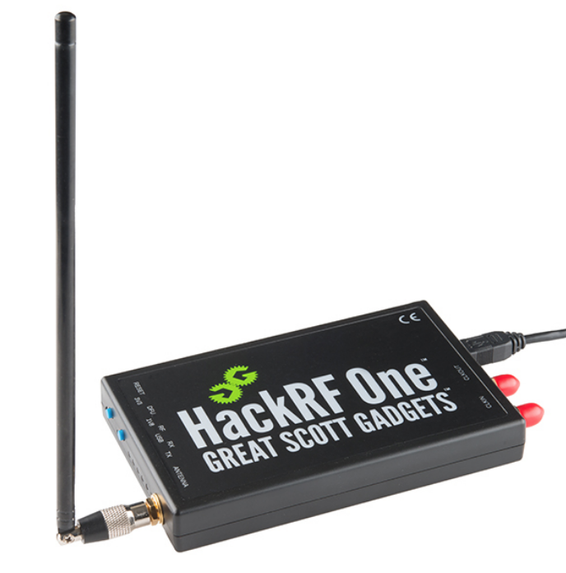
Tools of the Trade
HackRF One
Half-duplex transceiver
1 MHz – 6 GHz Operating Frequency
BladeRF
Full-Duplex
300MHz - 3.8GHz
Lime SDR
100kHz – 12GHz
Full Duplex

Slide 10
Common Attacks
Interception & Replay of RF Transmission.
Radio jamming
GPS Spoofing
Attack Methodology
Analyzing Radio Spectrum to discover frequencies communication band.
Investigating the signals.
Recording and Replaying the signals.

Slide 11
1.Exploring SDR with Hackrf and tuning in air Listening to live station with the help of Michael Ossmann libraries. Re-transmitting captured packets only for demo purpose. 2.Investigating Walkie-Talkie communications 3.Controlling Radio device 4.GPS Spoofing
Demo

Slide 12
REFERENCES
https://en.wikipedia.org/wiki/Software-defined_radio
https://github.com/mossmann/hackrf/wiki/Getting-Started-with-HackRF-and-GNU-Radio
https://www.youtube.com/watch?v=kuubkTDAxwA
https://www.youtube.com/watch?v=nUrw9aHrKTY
https://github.com/osqzss/gps-sdr-sim
Note: We have used media and some content from many resources to make this presentation, we warmly thanks to all resources. Special Thanks to nullDubai for giving this opportunity and GBM for hosting a venue.
Notes:
💖

Slide 13
Thanks! Any Questions?

